Slide 1


The Java Legacy Code Survival Guide
Add Features Without Fear
Steven Diamante August 14, 2025
Notes:
Imagine having to add a feature into a codebase that is highly coupled, hard to understand, and has huge files with thousands of lines of code. I love legacy code!
A lot of developers don’t
I’ve always enjoyed improving code design and adding automated tests
I’ve also learned from those mistakes. I’ve come into new codebases—deleted tons of dead code and created domain models and better abstractions so even the product owner could understand what the code is doing.
This talk is about overcoming the fear of legacy code by learning the tools & techniques
that software menders use to work effectively with legacy code.

Slide 2
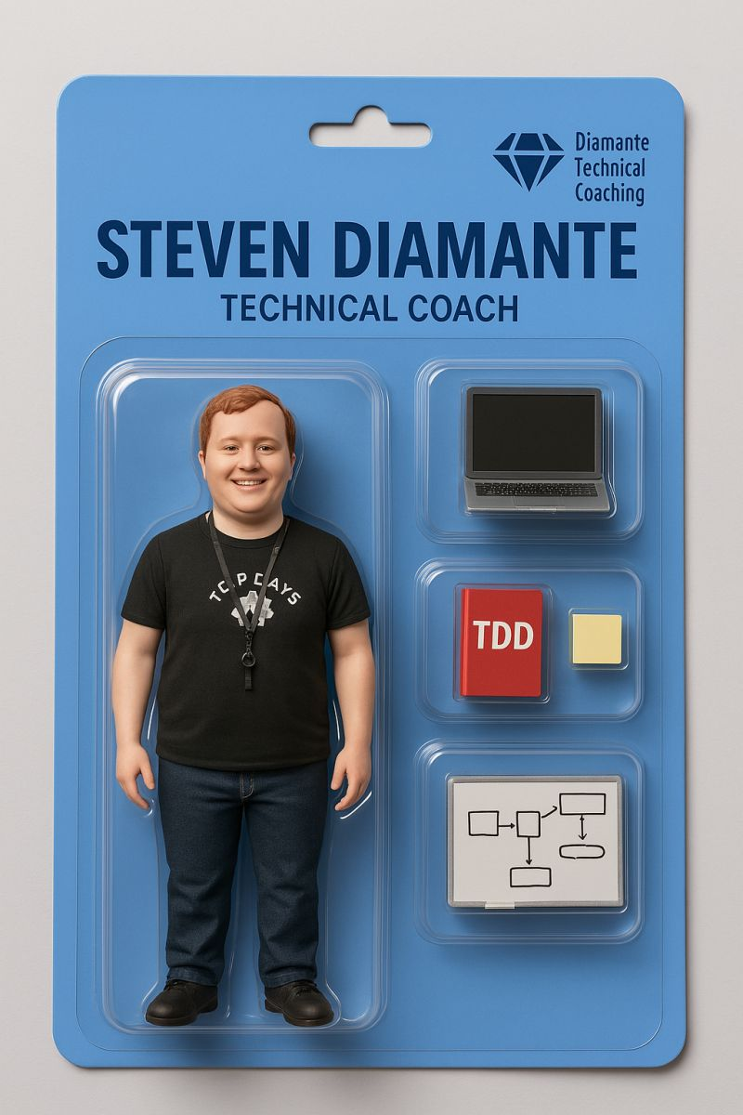



The Quest
Who am I?
Lives in Raleigh, NC
Software Craftsman
Building AI solutions at Artium AI
Musician & Meditator
Notes:
I coach developers on technical practices like social programming, TDD, refactoring, and legacy code coping mechanisms

Slide 3

Why does changing legacy code feel risky?
Legacy Code is profitable software that I’m afraid to change
no tests
hidden side effects
logic and I/O mixed together
changing one thing, breaks another
Notes:
There’s many different definitions of Legacy Code.
code without tests
code that’s been inherited, etc.
it’s in the eye of the beholder—It’s a feeling (subjective)
Legacy Code is valuable software that I’m afraid to change
it’s all about perspective. One person’s prison is another’s playground (makers vs. menders)

Slide 4

Surviving Legacy Code Takes More Than Courage
Legacy Code = 🐉
It’ll burn you if you charge in blind
Most would rather run than fight it
You need the right gear
🛡️ Shield = Characterization Tests
🗡️ Sword = Refactoring
🔥 Torch = Logs & Observability
👥 Scout = Social Programming
Notes:
It’ll burn you if you charge in blind
You need a gameplan
Most would rather run than fight it
Legacy code has this inherit healthy amount of fear
You need the right gear
You wouldn’t fight a dragon with your bare hands
Tools can help us to tackle legacy code more effectively

Slide 5
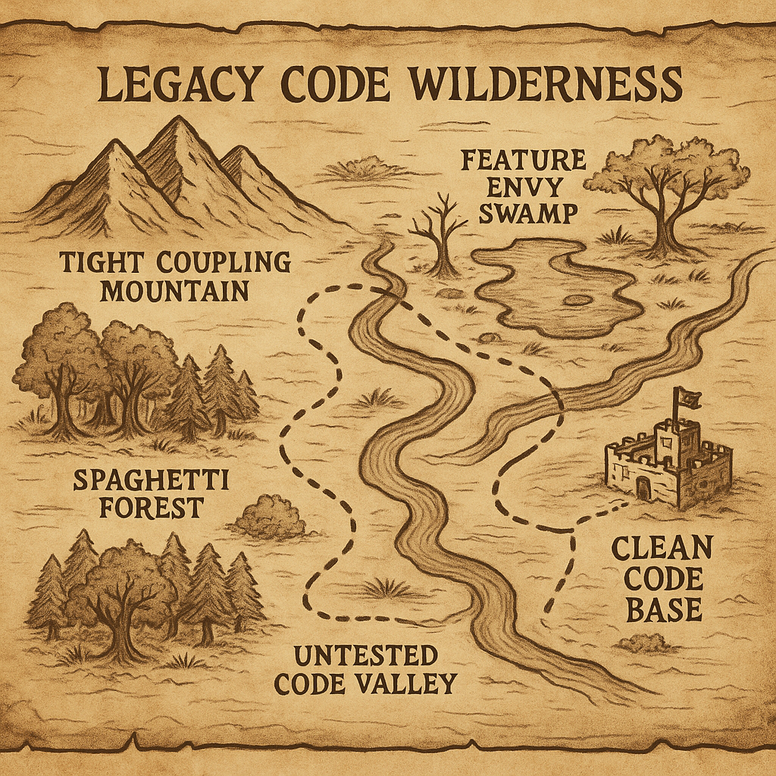
The Legacy Code Quest
🕵️ Step 1: Explore the Code
⚔️ Step 2: Break Dependencies
🛡️ Step 3: Build Safety Nets
🔄 Step 4: Refactor Carefully
🏰 Step 5: Add New Feature With Confidence

Slide 6
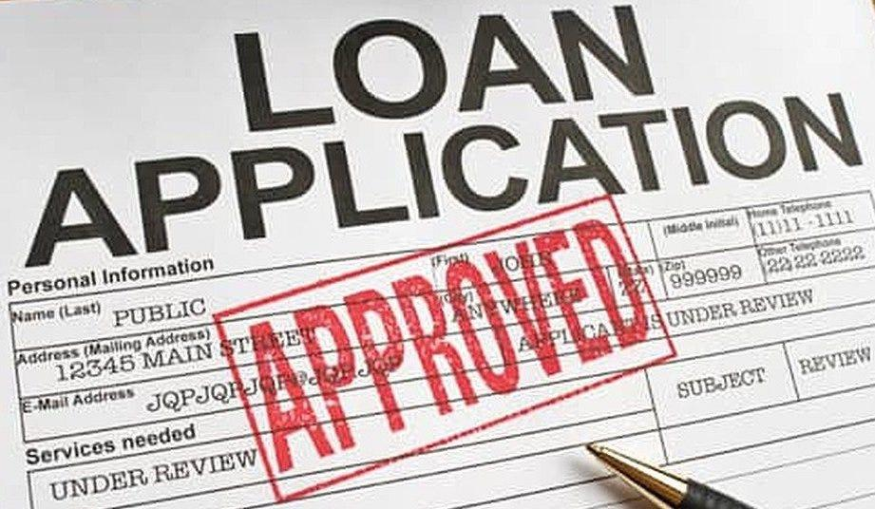
New Requirement
Flag certain applications for Manual Review
🔎
✅ ❌
Notes:
Explain app
New requirement: Add Needs manual review status.
Run the application and show the approved state.

Slide 7
🕵️ Step 1: Explore the Code
Notes:
Understand what you’re dealing with. Find the monsters (pain points). Map the terrain (dependencies).
Look at LoanApplicationService.java
Identify potential pain points to testing
Identify seams
Show feature for Needs Manual Review application status
Attempt to write the test and describe the problems associated with testing this code

Slide 8

⚔️ Step 2: Break Dependencies
Subclass and override
Peel
Peel and slice
Dependency injection
Notes:
Dependency Breaking Techniques: Legacy Code Paradox
Show Peel and Peel & Slice
Credit Score API & Postgres DB running in Docker
Peel -> API
docker stop loan-management
Peel and Slice -> Repo

Slide 9
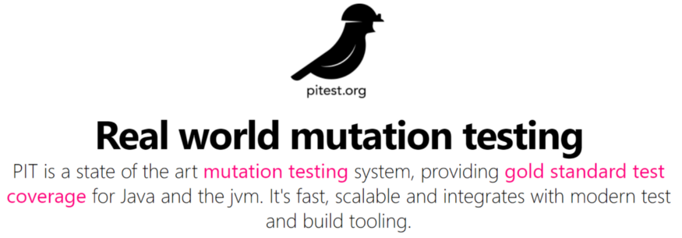

🛡️ Step 3: Build Safety Nets
Notes:
Add tests before making any changes. Know when you break something.
Approvals are great at quickly adding tests for large chunks of code.
Easy to assert a large output.
Great for legacy code!
Unit tests are more of a time investment
most times end up getting rewritten
after the refactoring since the tests are difficult to write from a behavior standpoint with the code tangled
Mutation testing can be used to test the quality of the approval tests.
rejectedLoans test (rejectedLoans)
Run test coverage
approvedLoans test (approvedLoans)
verifyAll (allRejectedLoans)
Test coverage
Remove @SpringBootTest
Mutation tests (build/reports/pitest/index.html)
I discard Approvals once they have served their function

Slide 10
🔄 Step 4: Refactor Carefully
Goal: Split up I/O and business logic so methods are pure and trivial to test
Refactoring System
🍊Low Hanging Fruit
🏷️ Improve names
♻️ Spot and remove duplication
📦 Extract code paragraphs
🧩 Find hidden Value Objects and Services in the class and pull them out

Slide 11

🔄 Step 4: Refactor Carefully
Refactoring System
🍊Low Hanging Fruit
— remove clutter
— resolve linting errors
— reformat file
Notes:
Continuous test runner — ./gradlew test -t

Slide 12
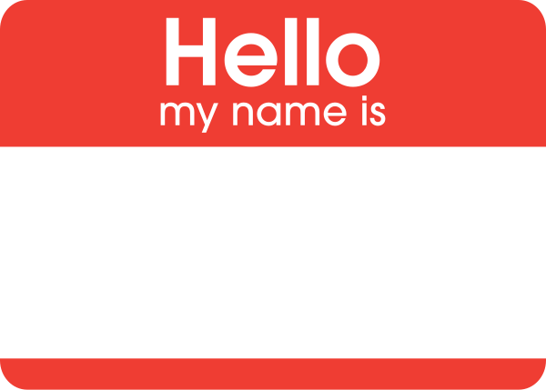
🔄 Step 4: Refactor Carefully
Refactoring System
2. 🏷️ Improve names
— scan top to bottom
— honest names
— be careful of renaming DTOs (API responses, database column names, etc.)
Notes:
Rename income, debt
Be careful of renaming DTOs.

Slide 13

🔄 Step 4: Refactor Carefully
Refactoring System
3. ♻️ Spot and remove duplication
— be pragmatic
— comes in many forms, not just copy paste
Notes:
Inline variables
Spot duplication

Slide 14

🔄 Step 4: Refactor Carefully
Refactoring System
4. 📦 Extract code paragraphs
— comments are helpful hints
common paragraphs:
if-else blocks
loops
try-catch
Notes:
Skip this part since this this code example doesn’t have code paragraphs worth extracting

Slide 15

🔄 Step 4: Refactor Carefully
Refactoring System
5. 🧩 Find hidden Value Objects and Services in the class and pull them out
— introduce domain model
— helps to separate business logic from I/O
— the domain starts to live in the code
Notes:
Map request to domain (LoanApplication)
Map domain to entity
Map domain to response
Extract & move determineLoanStatus
Extract LoanStatus enum and move to domain package
Extract Value Objects, CreditScore, DebtToIncomeRatio, & LoanToIncomeRatio. Add unit tests
(only do creditScore, invalidCreditScore and fast-forward the others)
LoanApplicationServiceTest -> unit tests only look at status

Slide 16
🏰 Step 5: Add New Feature With Confidence
Notes:
Show only CreditScore to save time: Start with adding needsManualReview test to LoanApplication Test then going into CreditScoreTest

Slide 17
New Requirement
Flag certain applications for Manual Review
🔎
✅ ❌

Slide 18
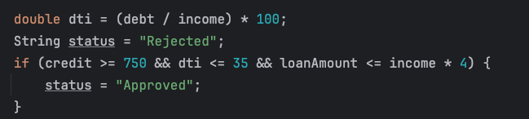
Common code smells
Feature Envy / Primitive Obsession
Magic Strings/Numbers
Mixed concerns
Long methods

Slide 19

What about GenAI?
Great collaborator
Coding agents not ready for Legacy…yet
Devs still need design knowledge
LLMs could create more legacy code
Notes:
Great collaborator
Explaining codebases
Creating architectural diagrams of current systems
Suggesting refactoring approaches
Coding agents not ready for Legacy
Of course, this could change but I think asking AI for suggestions on refactoring is a great use case.
But automated refactoring tools are safer and cheaper to pull off those refactorings.
When LLMs improve…bullet-proof testing will be essential
Devs still need design knowledge
We need to have a shared vocabulary with the LLM. Code smells and refactoring already exist for that. Learning these will be vital.
We still face the design stamina hypothesis in a world of coding agents
LLMs could create more legacy code
If AI wrote the code and you don’t understand it and you ship it to prod, isn’t that legacy code?
I wouldn’t add tests using LLMs
Need to be able to trust tests
Missed opportunity for Theory building
The tests it produces are not readable specs I do add tests with LLMs after refactoring to a clean test fixture that is easy to understand and build on top of.
This helps the LLM be more consistent.

Slide 20
Key Takeaways
Cover and Modify
Sometimes you must break the rules to make progress
Micro commits
Requires practice in safe environments
Notes:
Cover and Modify
Mutation testing + Approvals
“Best” practices rarely apply in Legacy Code Rescue
Need to cut corners and do some not so great things in order to test and improve the code
Micro commits
Enables safe rollbacks
Checkpoints for refactoring
Requires practice in safe environments
Learning Hours! Katas! Coding dojos! Legacy Code Retreats!

Slide 21

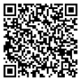


Legacy code won’t fix itself
Heroes will!
@SDiamante
linkedin.com/in/stevendiamante
diamantetechcoaching.com
Notes:
Be brave, bring some friends, and equip yourself with good tools and everything will be fine!
I offer technical coaching services for individuals and teams so if you need some help, let’s connect and see how I can help

